Slide 1

2015 CoACT Data Analysis

Slide 2
Outline
Macro Level Analysis
Network Level
School Level
Individual School – 452 Case Study

Slide 3
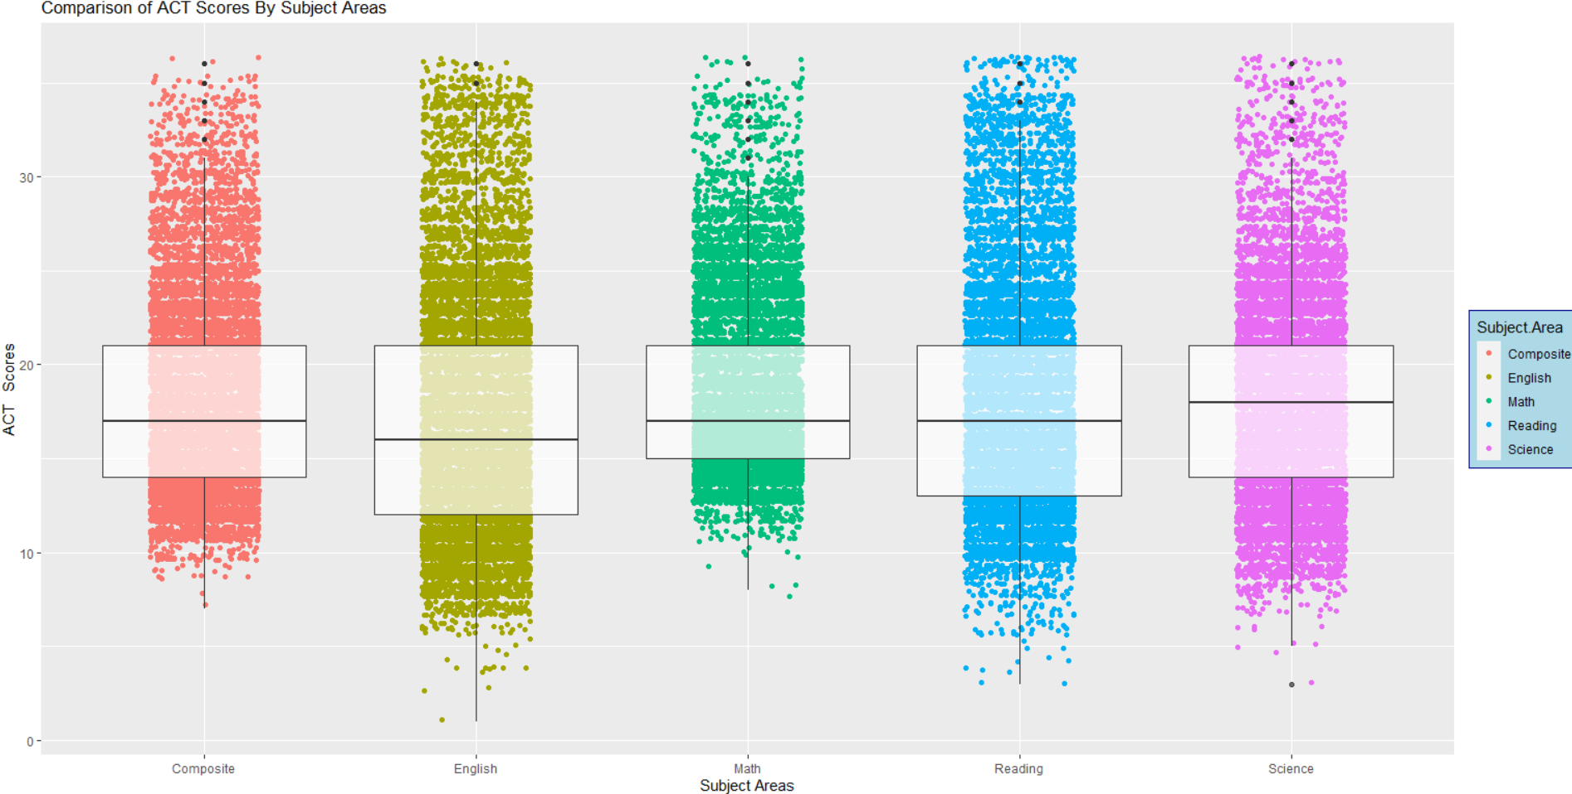
Macro Analysis

Slide 4
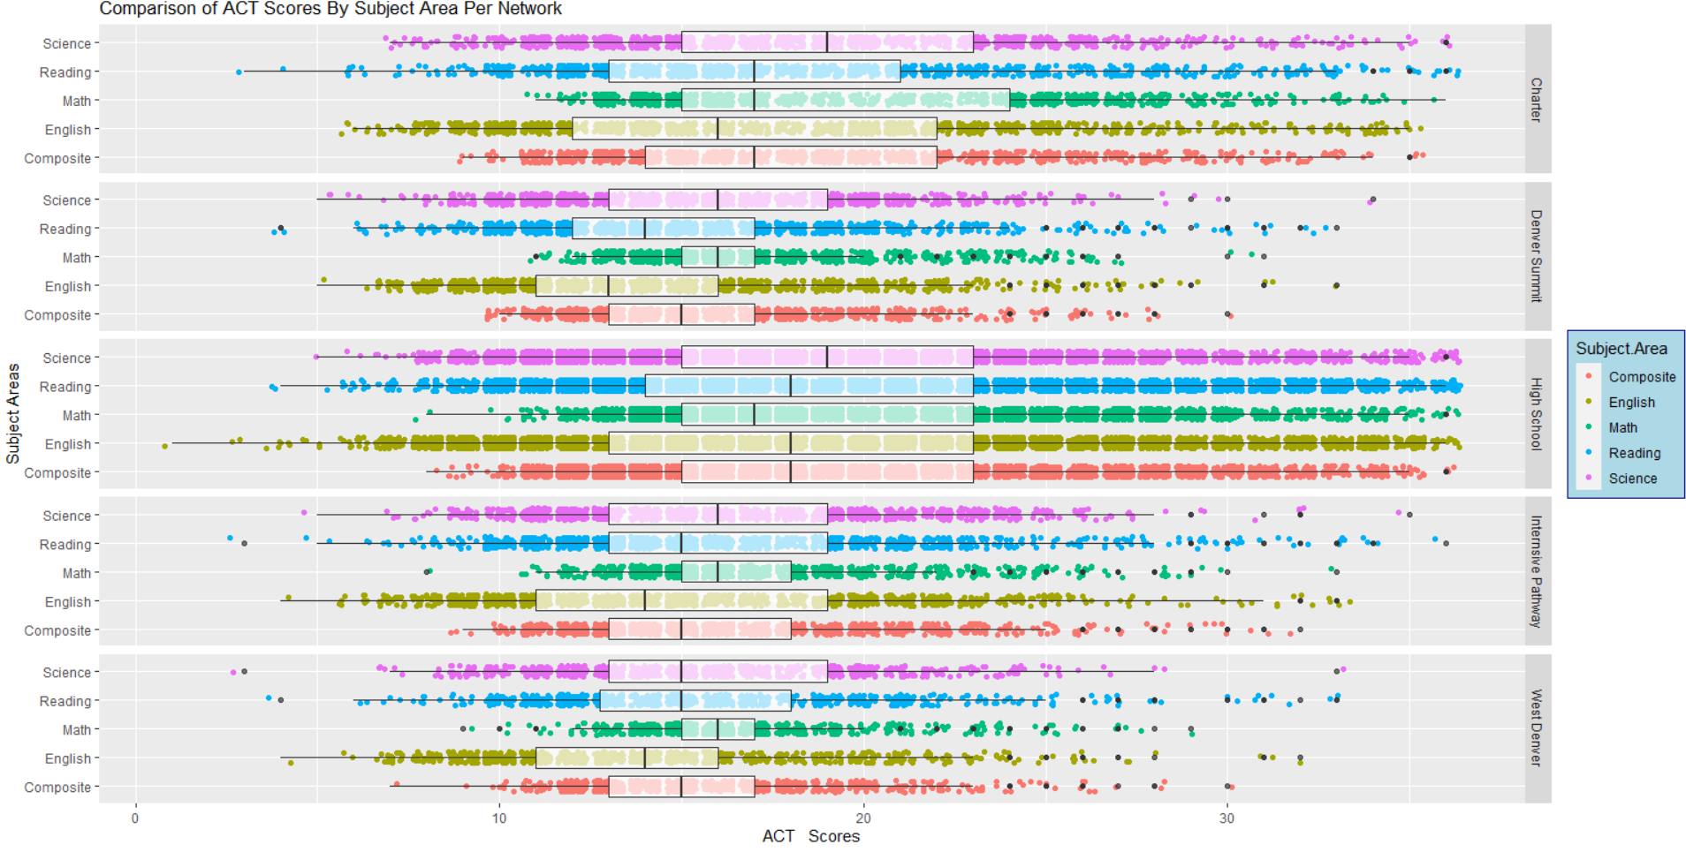
Network Level

Slide 5
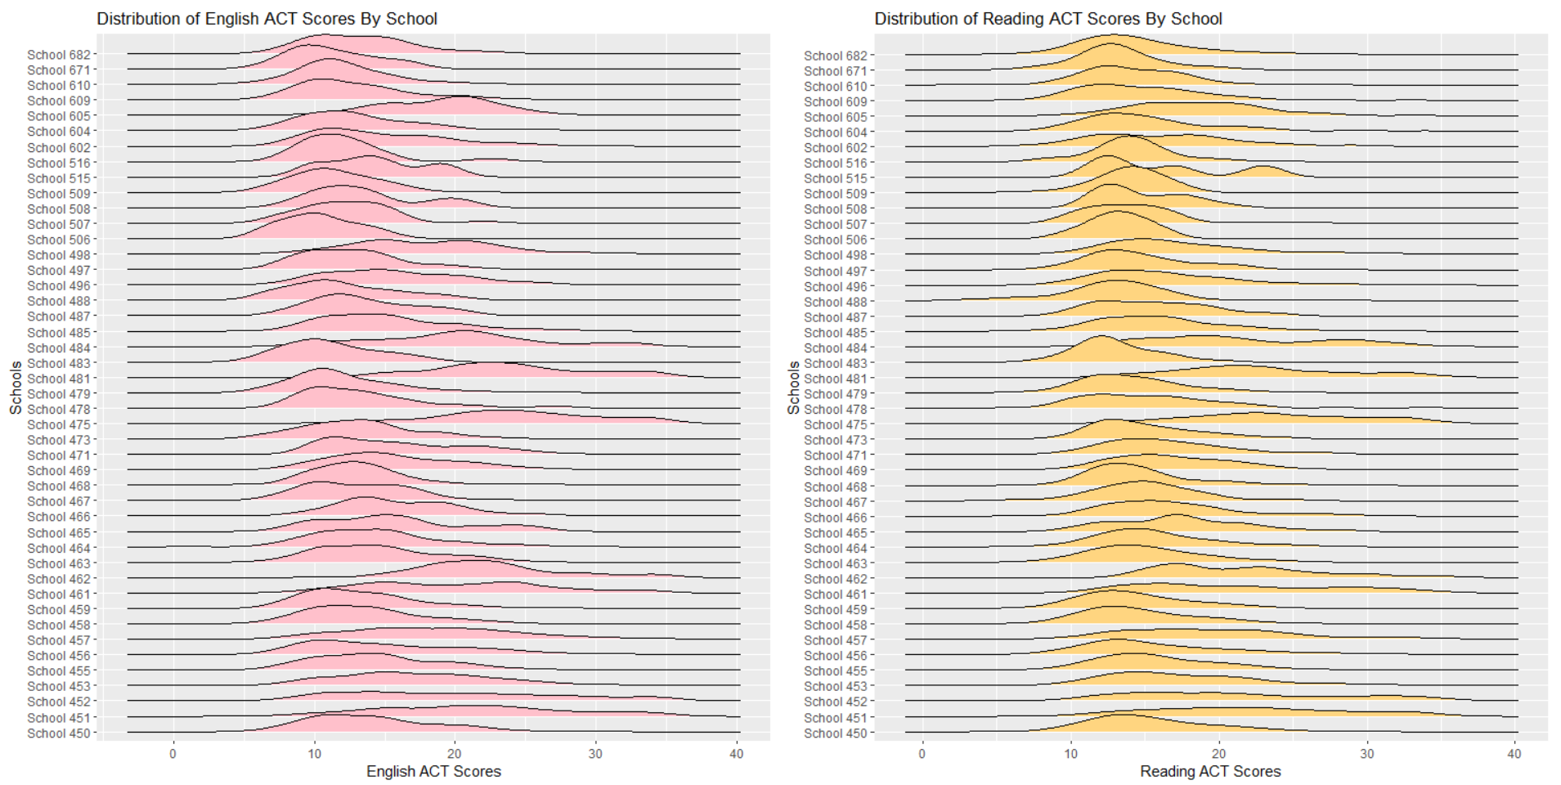
School Level Analysis

Slide 6
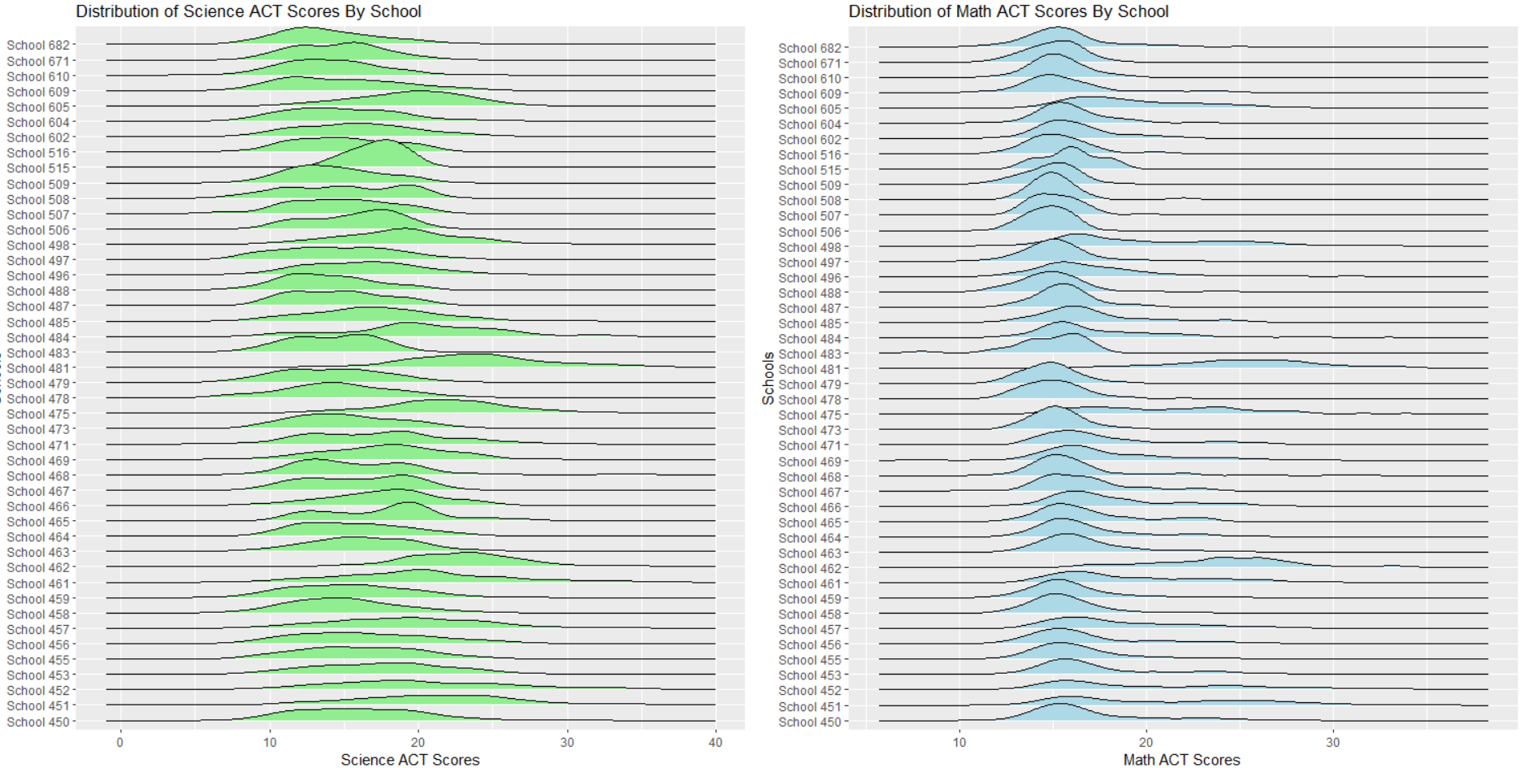

Slide 7
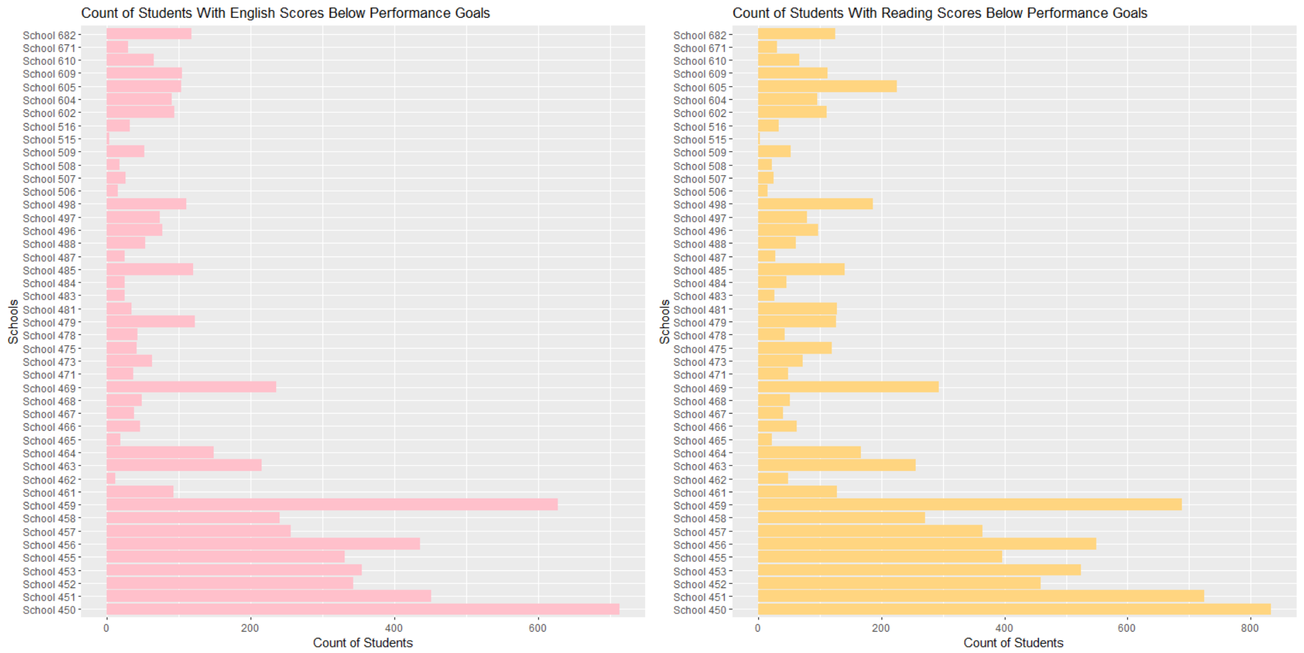

Slide 8
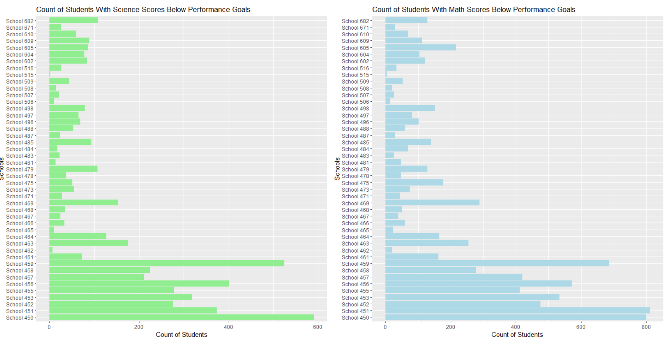

Slide 9
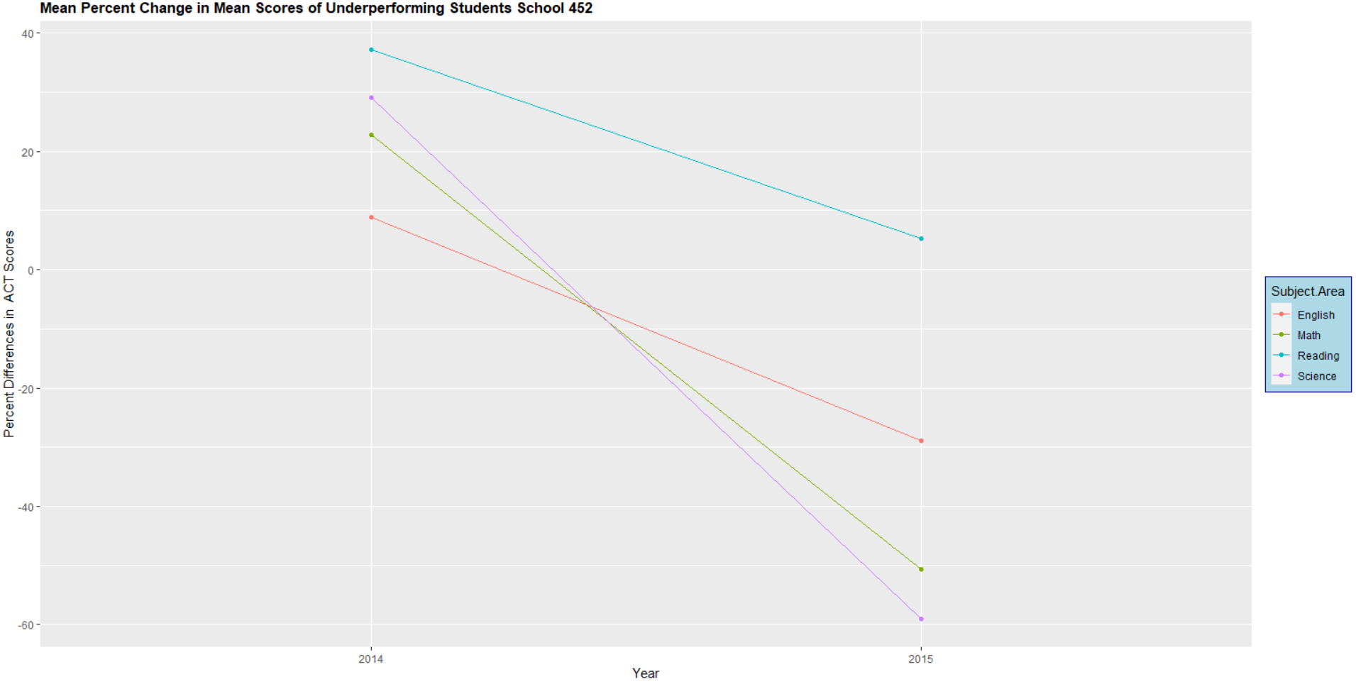
School 452

Slide 10
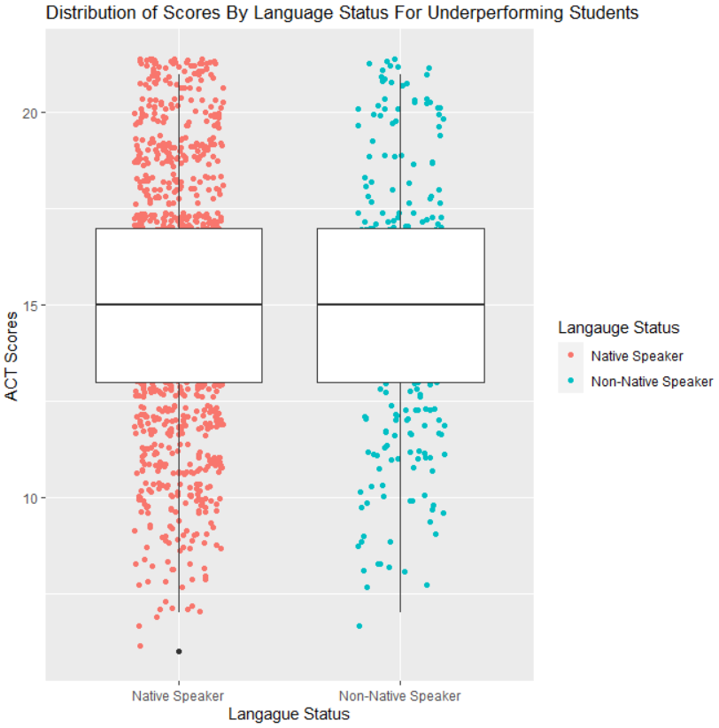
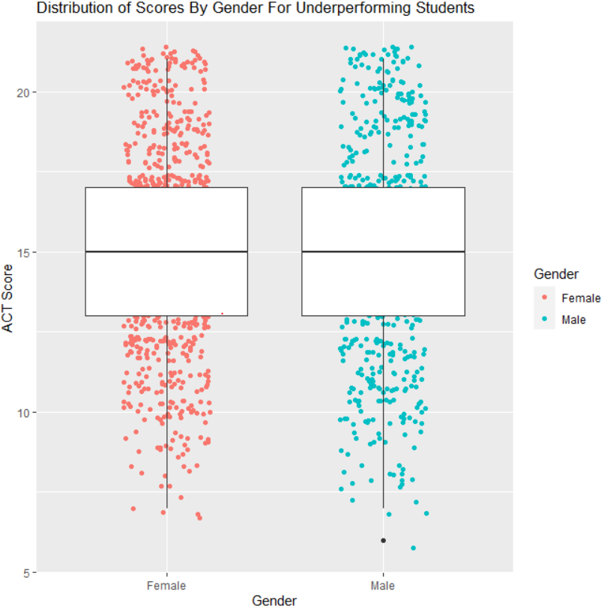

Slide 11
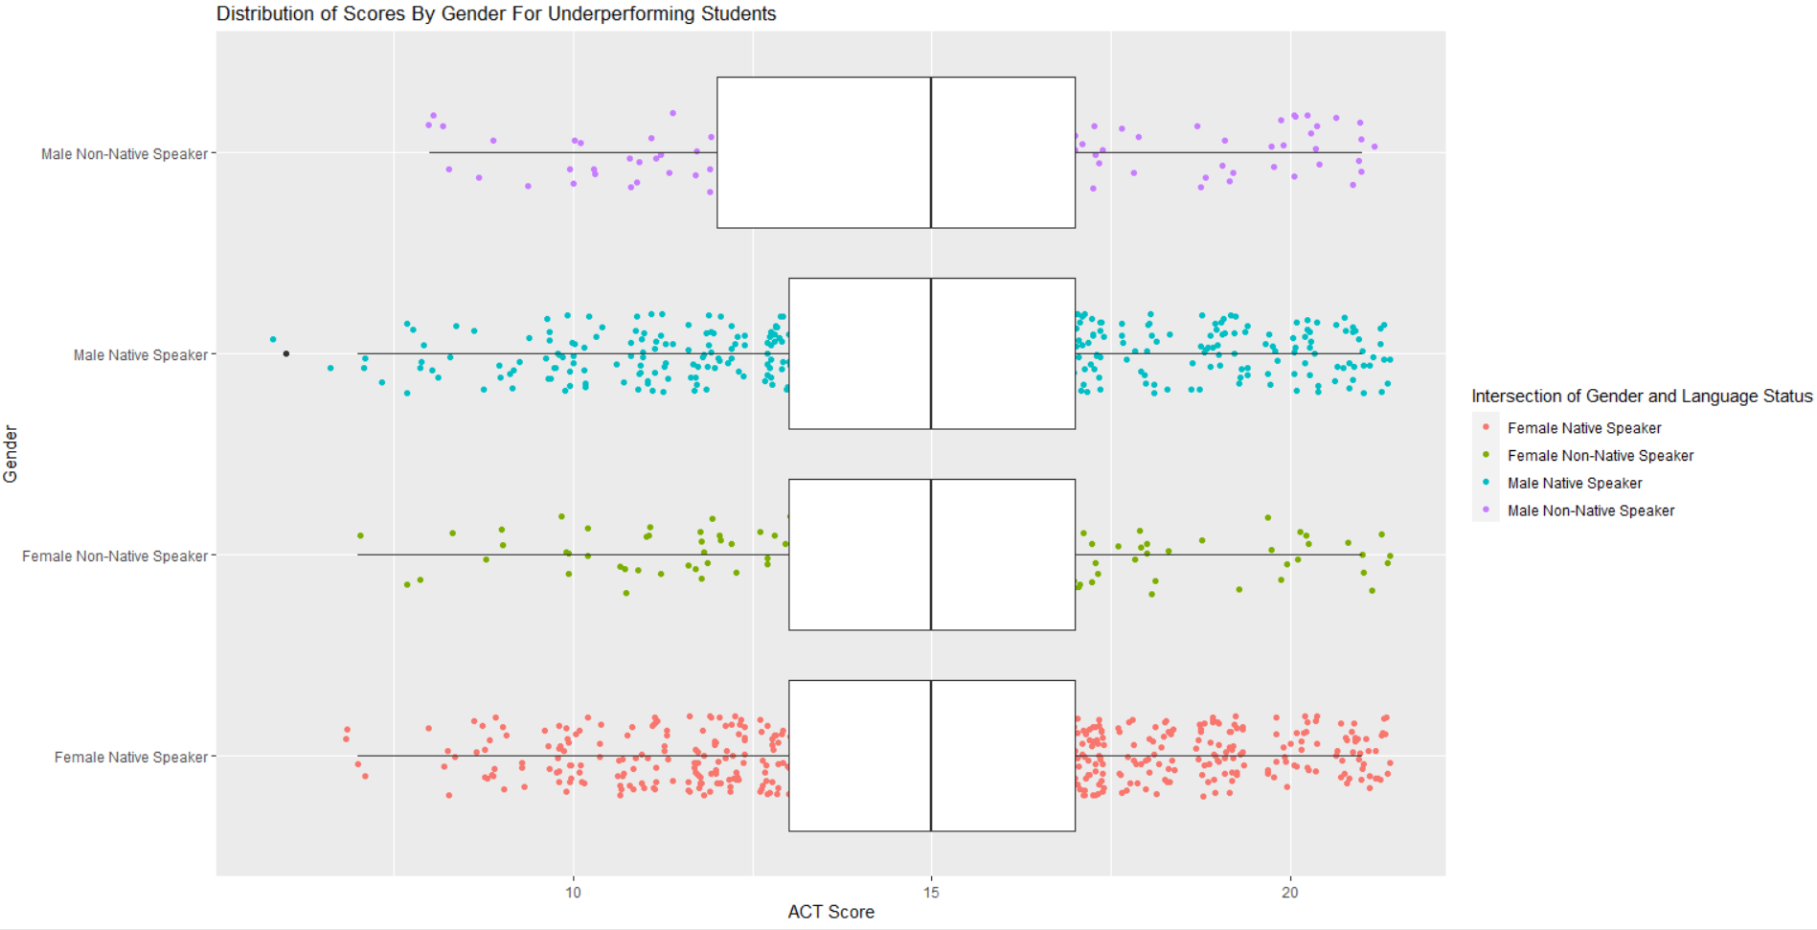

Slide 12
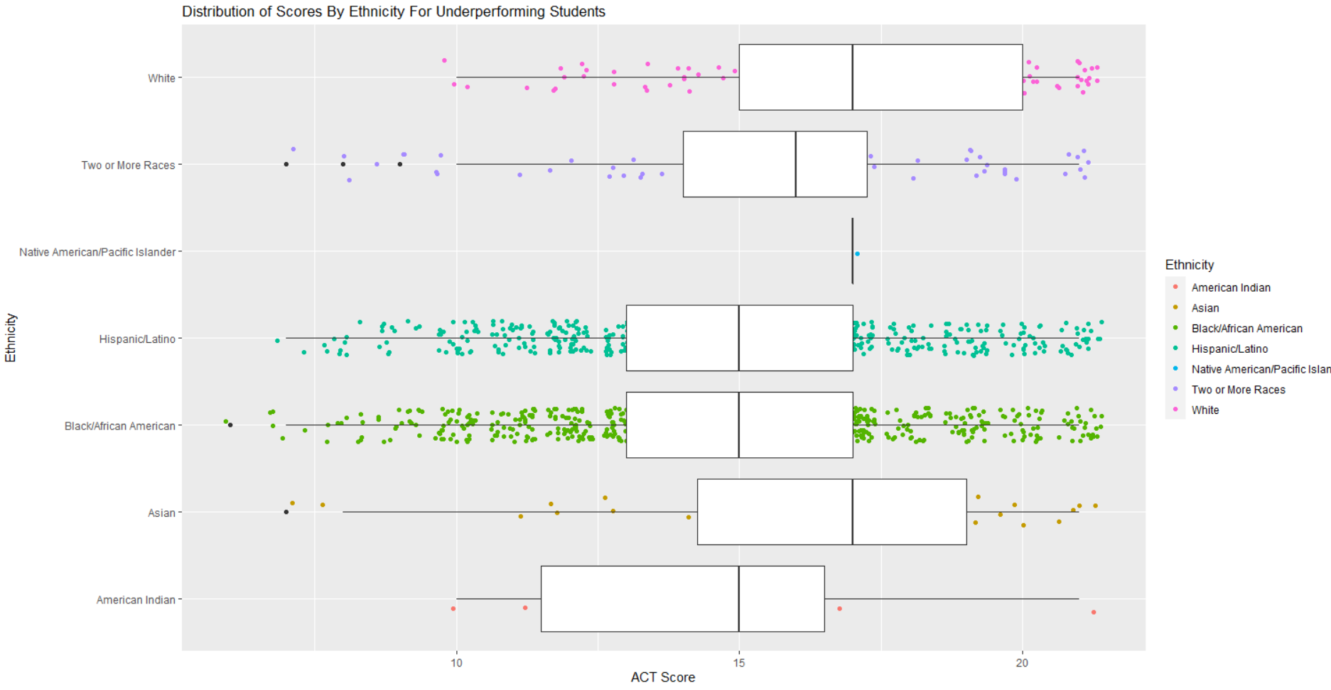

Slide 13
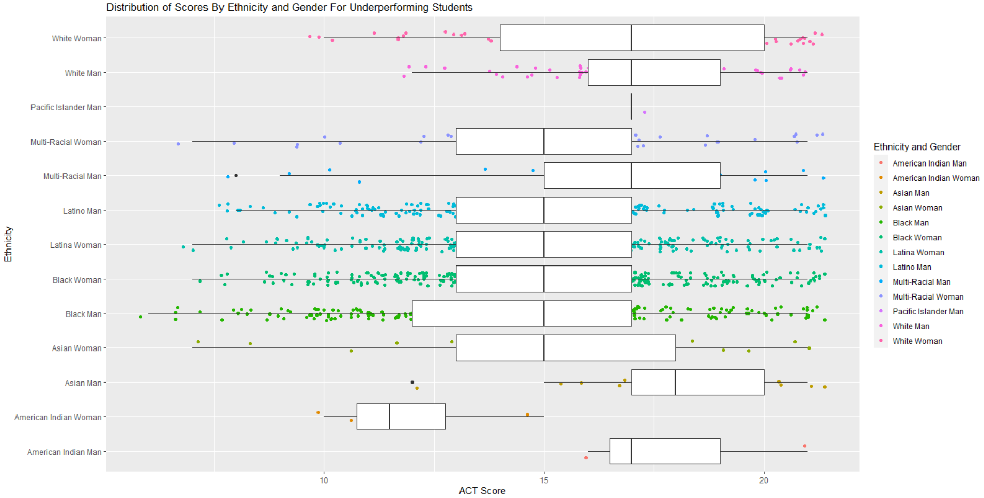

Slide 14
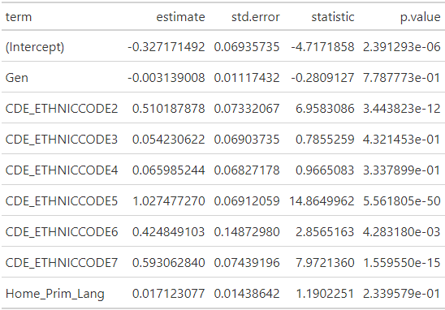
Regression Analysis
Probit Model
Binary dependent variable
Dependent Variable is if a student was prepared based on threshold values
Interaction Terms Not included due to VIF

